Slide 1

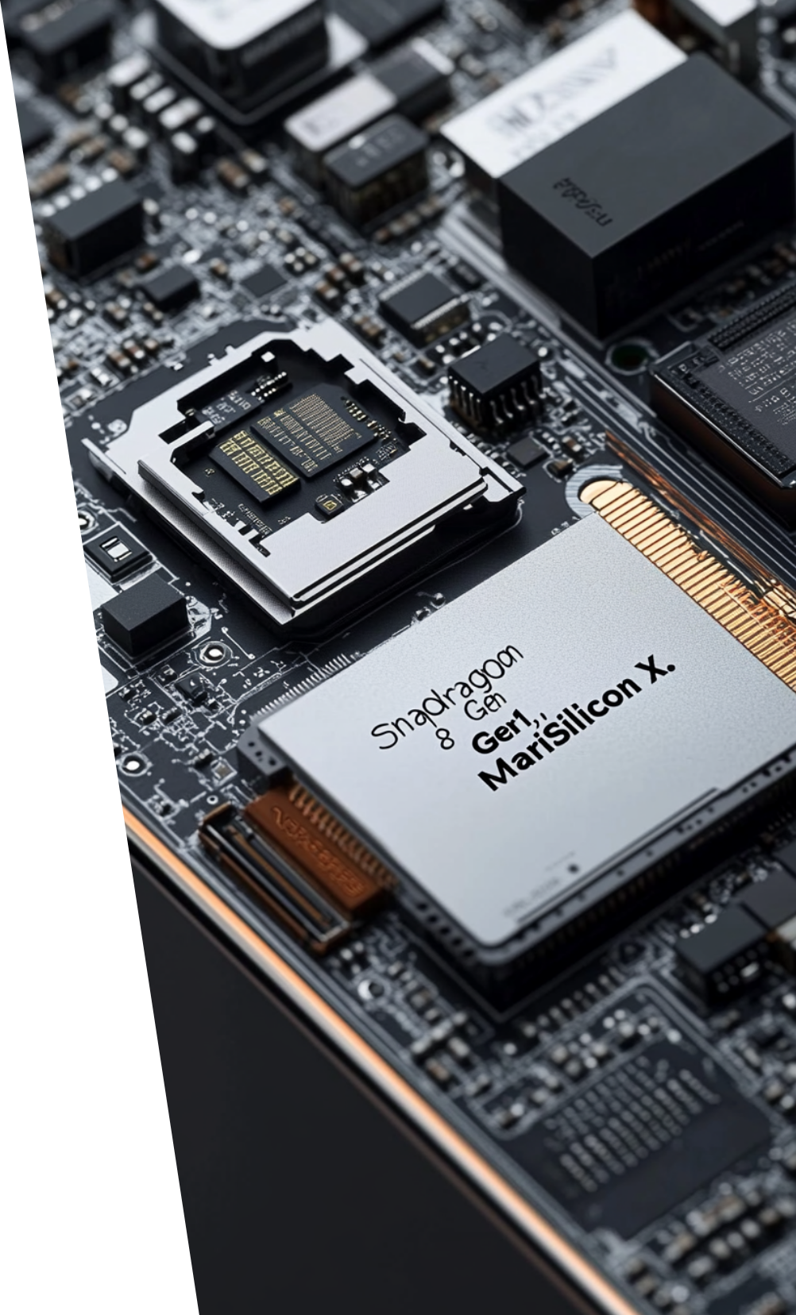
Evolution of Apple Siri: From Voice Assistant to Smart AI
Revolutionizing personal assistance through cognitive computing
Presented by: Abhinav Arora (102316069)
Roushni Sharma (102316119)
Harnimarpreet Singh (102316032)
Presented to: Dr. Manisha Malik

Slide 2

CONTENTS
1. Introduction
2. The Birth of Siri
3. Siri's Integration into Apple Ecosystem
4. Advancements in NLP and Machine Learning
5. Siri's Context Awareness and Personalization
6. Siri vs Other Voice Assistants
7. Siri in Accessibility and Wellness
8. Privacy and Ethical Considerations
9. Challenges and Limitations
10. Future of Siri

Slide 3

What is Siri?
Role in cognitive computing
Importance in the AI ecosystem
Daily use in millions of Apple devices

Slide 4




The Birth of Siri
Originated from SRI International's CALO (DARPA-funded)
Acquired by Apple in 2010
1
2
4
3
Marked the beginning of personal AI interactione
First AI voice assistant on smartphones (iPhone 4S, 2011)

Slide 5




Siri's Integration into Apple Ecosystem
Seamless functionality across iPhone, iPad, Mac, Apple Watch, Apple TV
1
2
Hands-free interaction with “Hey Siri”
4
3
Foundation of Apple’s AI strategy
Smart integration with built-in apps and HomeKit

Slide 6







Advancements in NLP and Machine Learning
Natural Language Understanding (NLU) improvements
On-device processing with Neural Engine
Use of CoreML and Deep Neural Networks
Contextual awareness in follow-up questions

Slide 7

Cognitive Computing in Siri
Learning
Reasoning
Understanding
Interaction
Adaptation
Personalization
Notes:
Siri applies cognitive computing principles by continuously analyzing user input, adapting to preferences, and improving its responses over time through machine learning and AI

Slide 8





Siri's Context Awareness and Personalization
1
2
Learns from user habits, locations, routines
Suggests context-aware actions
Powers automation through Siri Shortcuts
Uses calendar, reminders, and usage patterns
4
3

Slide 9


Siri vs Other Voice Assistants
1
Comparison with Alexa, Google Assistant
2
Strengths: Privacy, Ecosystem Integration
3
Weaknesses: Limited conversational depth
4
Performance in smart home and on-device commands
Notes:
Siri’s greatest strength lies in its privacy-focused design and seamless interaction across Apple devices, something that sets it apart from competitors

Slide 10


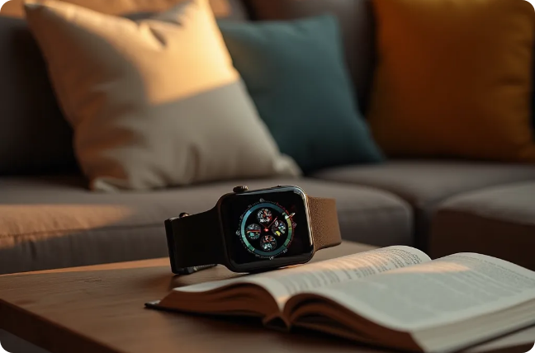

Siri in Accessibility and Wellness
Supports VoiceOver, Speak Screen, and Voice Control
Helpful for visually/motor-impaired users
Fall detection and emergency call with Apple Watch
Reminders for medication, exercise, breathing

Slide 11




Privacy and Ethical Considerations
1
On-device intelligence to reduce data sharing
Apple's privacy-centric approach
2
4
Ethical AI design built into system architecture
3
Transparent data handling, user control

Slide 12




Challenges and Limitations
Lacks flexibility of modern generative AI
Dependency on Apple's closed ecosystem
Struggles with multi-language and context retention
Requires improvements in conversational AI depth
2
3
1
4

Slide 13

Future of Siri
Integration with generative AI (Apple Intelligence 2024+)
Vision Pro compatibility for immersive assistance
Evolution toward more human-like dialogue
Emotion and user-context aware responses

Slide 14

Thank You

